Slide 1
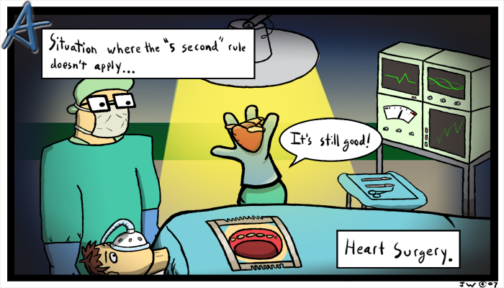
Cardiovascular System
heart and blood vessels

Slide 2
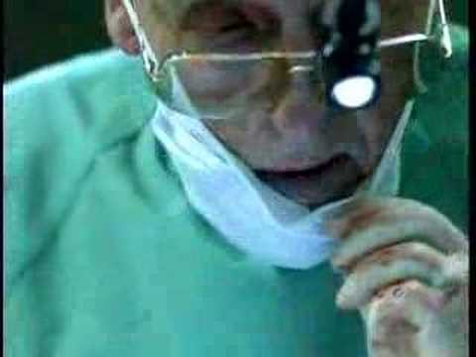
Tainted Love…?

Slide 3
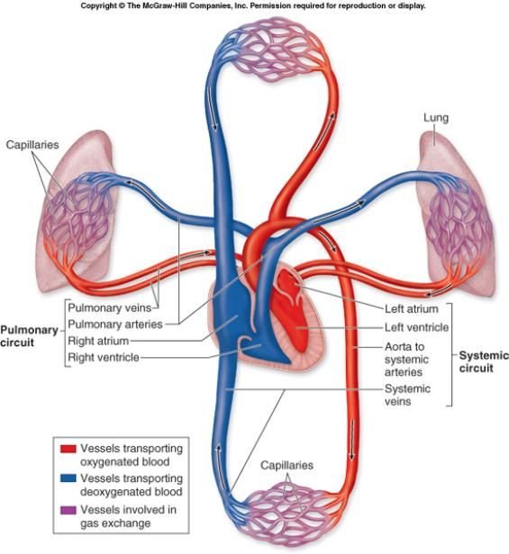
Systemic Circulation – delivers blood to all body cells and carries away waste
Pulmonary Circulation – eliminates carbon dioxide and oxygenates blood (lung pathway)

Slide 4
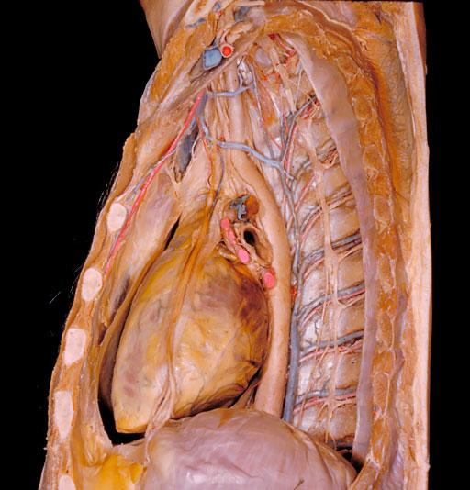
Structure of the Heart
Heart Size – about 14 cm x 9 cm (the size of a fist).
Located in the mediastinum (space between lungs, backbone, sternum), between the 2nd rib and the 5th intercostal space.
The distal end of the heart is called the apex.

Slide 5
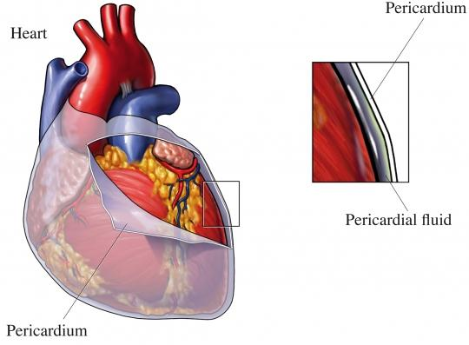
Fibrous Pericardium encloses the heart (like a bag) and has 2 layers
visceral pericardium (inner)
and parietal pericardium (outer, attached to diaphragm, sternum and vertebrae)

Slide 6
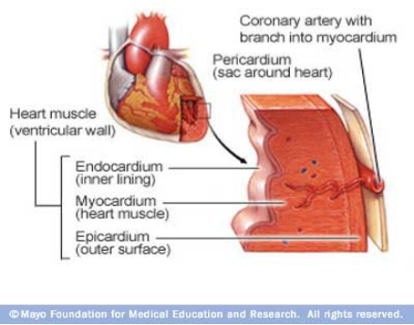
Pericardial cavity – contains fluid for the heart to float in, reducing friction
Wall of the Heart
Epicardium – outer layer, reduces friction
Myocardium – middle layer, mostly cardiac muscle
Endocardium – thin inner lining, within chambers of the heart

Slide 7
Heart Chambers & Valves
Your heart is a double pump. Circulation is a double circuit: Pulmonary (lungs only) and systemic (rest of the body)
Heart has 4 chambers:
  2 Atria – thin upper chambers that receive blood returning to the heart through veins.. Right and Left Atrium
  2 Ventricles – thick, muscular lower chambers. Receive blood from the atria above them. Force (pump) blood out of the heart through arteries. Right and left ventricle.
Septum – separates the right and left sides of the heart

Slide 8
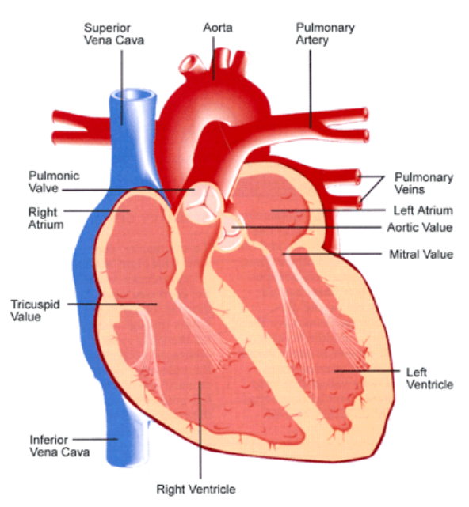

Slide 9
Valves of the Heart – allow one-way flow of blood.
4 total
(2 Atrioventricular Valves (AV) & 2 Semilunar valves)
  Left Atrioventricular valve – also called the bicuspid valve or mitral valve. Between left atrium and ventricle
  Right Atrioventricular valve – also called the tricuspid valve. Between right atrium and ventricle
Aortic Semilunar – or just aortic valve. Between the left ventricle and the aorta
Pulmonary Semilunar, or just pulmonary valve. Between the left ventricle and the aorta

Slide 10
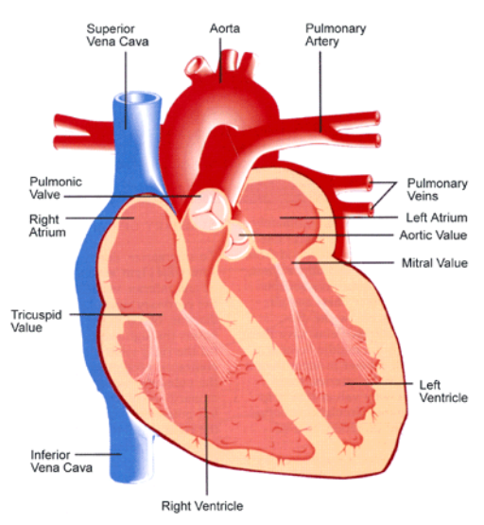
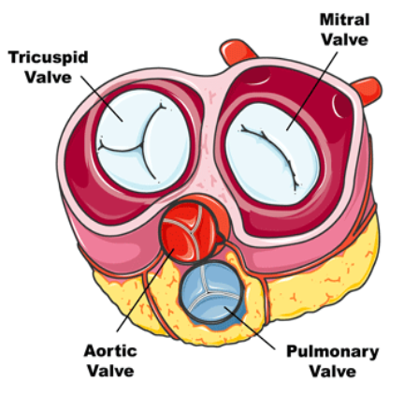
Mitral = bicuspid (left side)
Tricuspid (right side)
Aortic and Pulmonary are both semilunar valves

Slide 11
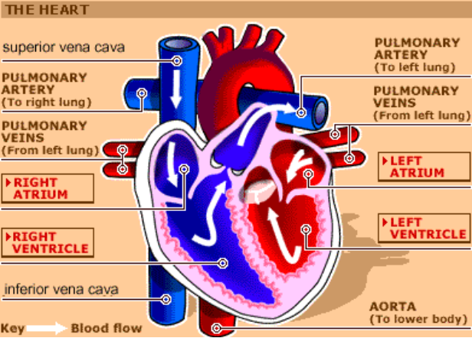


Path of Blood Flow
Label the heart diagram on your notes!
*This is a good time to watch some of the heart animations and tutorials.

Slide 12
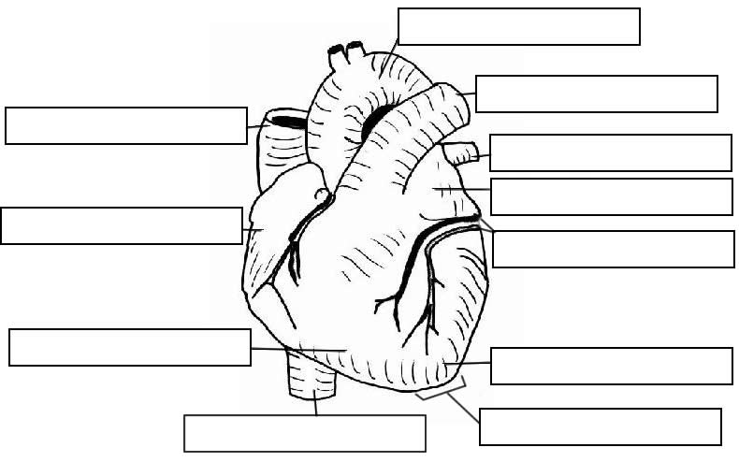

Slide 13
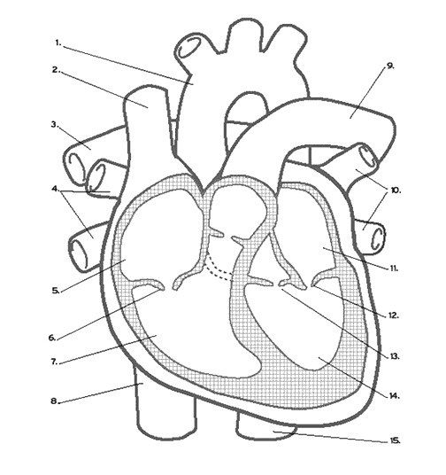

Slide 14
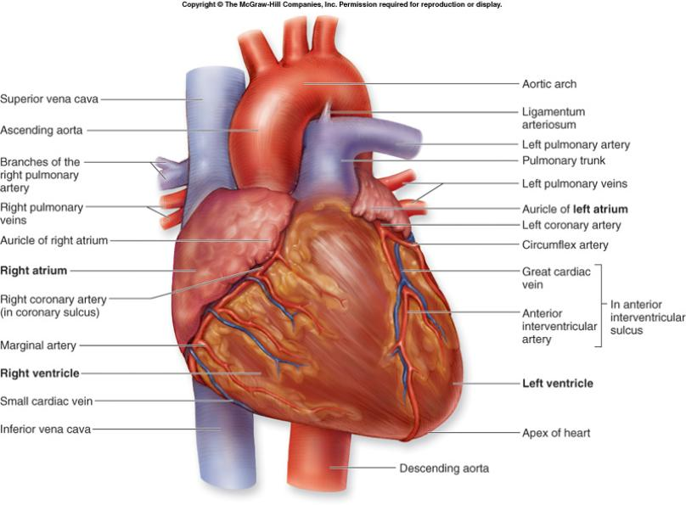
Check your labels!

Slide 15
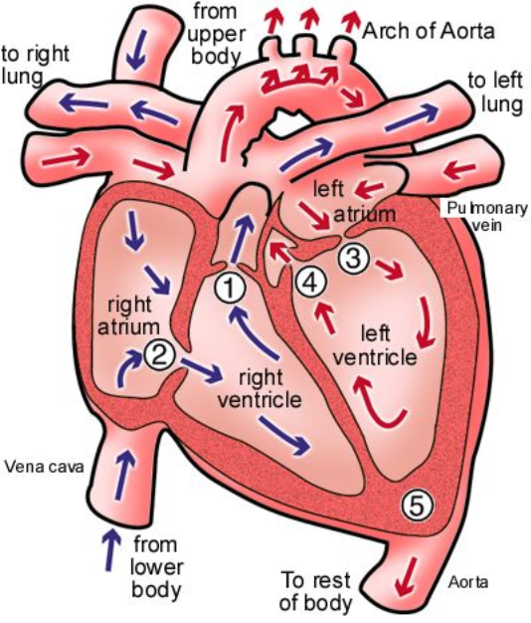
Name the valves
(#5 is not a valve)

Slide 16
1 Pulmonary Valve
2 Tricuspid Valve
3 Mitral (Bicuspid) Valve
4 Aortic Valve
5 Heart Apex

