Slide 1
Homeostasis in the Human Body
LA.910.2.2.3 The student will organize information to show understanding or relationships among facts, ideas, and events (e.g., representing key points within text through charting, mapping, paraphrasing, summarizing, comparing, contrasting, or outlining)

Slide 2
Ectoderm vs Endoderm
Ecto/derm: Outside/Skin
Endo/derm: Within/Skin
An ectoderm is an organism that is dependent on the environment to provide warmth
Examples: Reptiles, fish, etc… (“cold-blooded”)
An endoderm is an organism that is not dependent on the environment and can provide its own warmth (“warm-blooded”)
Examples: Humans, dogs, etc..

Slide 3
What is homeostasis?
Homeo/stasis: Same/standing still
What other ways do we maintain homeostasis?
pH
Fluid levels
Electrolyte levels (Sodium, Potassium, etc..)
Sugar levels
Blood pressire
Hormone levels

Slide 4
Homeostasis in Non-Living objects
Think of an air conditioner:
You have a set point, let’s say 75 degrees; set points tell what a particular value should be
The receptor, the thermostat in the room detects the change; it provides information about specific conditions (stimuli) in the internal environment.
The control center, the thermostat detects deviation from the set point and signals the effectors

Slide 5
Homeostasis in Non-Living objects
The effector causes responses in the internal environment; the air conditioner will turn on to bring the temperature back to 75 degrees.
Responses correct the change.

Slide 6
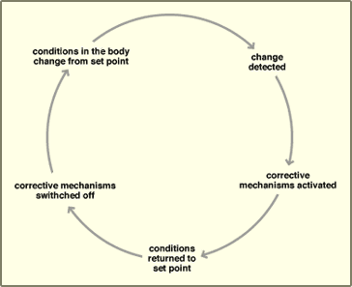

Slide 7
Negative Feedback
This is how we maintain homeostasis.
If our temperature gets too high, we sweat.
Sweating lowers the body temperature to normal
If our temperature gets too low, we shiver to bring it back up
Muscles shivering produce heat raising the temperature

Slide 8
Negative Feedback
Consider both cases:
sweating to lower temperature
shivering to raise body temperature
Both are negative feedback. Don’t think of negative feedback as a number scale.
i.e. Temperature increasing is negative feedback, if it is going back to the set point.

Slide 9
Positive Feedback
Positive feedback is when you increase the stimulus.
Very few cases of positive feedback
Positive feedback occurs when one event triggers another event, therefore increasing the first event, and so on…
Positive feedback is designed to push levels out of normal range.

Slide 10
Examples of Positive Feedback in the Human Body
Platelets causing blood clots when skin is cut. The presence of platelets and other cells attracts more and more cells, eventually clotting the cut, drying and scabbing over while the skin repairs.
Release of oxytocin during childbirth. The presence of oxytocin intensifies contractions until the baby is expelled.

